Slide 1


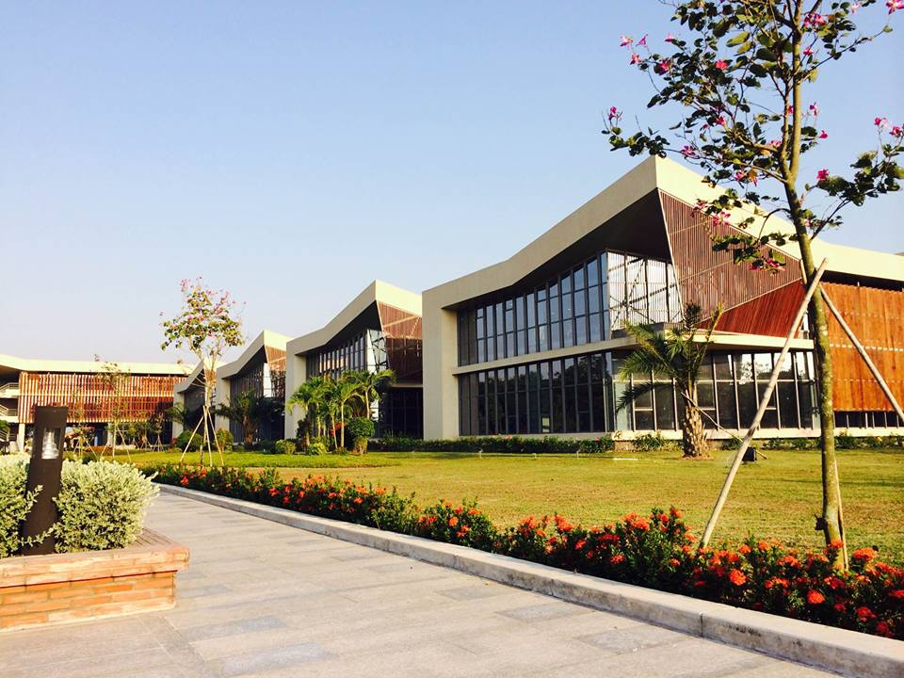
Re-Inspection
Report
By: nedd.phan
Date: June 2026

Slide 2

Re-Inspection Report_July 2026
Insp. times 305
Insp. times 898
Insp. times 561
TOP 5 COUNTRY AUDIT
TOP 5 MODEL AUDIT
TOP 5 DEFECT
VH
Model | % Fail
NIKE AIR WINFLO 12 (MS/WS) | 7,92%
JORDAN SPIZIKE LOW (GS) | 6,93%
NIKE SB FORCE 58 | 6,27%
AIR JORDAN 1 LOW SE (MS/WS) | 5,61%
JORDAN COURT CONNECT LOW (GS) | 4,62%
Insp. times: 282
VH2
Model | % Fail
NIKE AIR MAX EXCEE (MS/WS) | 17,65%
AIR WINFLO 11 GTX (MS/WS) | 2,94%
AIR FORCE 1 (GS) | 2,94%
NIKE AIR MAX SC (MS/WS) | 8,82%
NIKE INITIATOR (MS/WS) | 8,82%
Insp. times: 23
Model | % Fail
NIKE EBERNON LOW (MS/WS) | 26,74%
NIKE INITIATOR (MS/WS) | 17,44%
NIKE AIR MAX SC (MS/WS) | 9,30%
NIKE COURT VISION LOW (MS/WS) | 3,49%
NIKE COURT BOROUGH MID (GS) | 4,65%
JV
Insp. times: 99
Model | % Fail
NIKE COURT VISION LOW (MS/WS) | 20,21%
JORDAN 1 MID SE (PS/TD) | 11,16%
AIR JORDAN 1 MID SE (GS) | 10,53%
NIKE INITIATOR (MS/WS) | 8,42%
JORDAN 1 LOW ALT (PS) | 7,16%
JV2
Insp. times: 571

Slide 3
Re-Inspection Report_July 2026
COMPARISON OF THE TWO INSPECTIONS
BY
QC
 | Others
 | Wrinkle upper
 | Eyestay off center
 | Cleanness
 | Midsole/Outsole to upper bond gap
 | Over cement
 | Thread end
 | Miss match labeling on shoe or Outer carton and Inner box
 | Wrinkle bottom
 | Airbag quality/stain
 | Rocking
 | Sole attachment
 | Collar shape
 | Heel/Tip height inconsistent
 | Bottom Cosmetic
VH
BY
MA
BY
QC
At RED FRAME, We observed that after the Reinspection process, MA-Reinspection still detected Cleanness issues with no significant improvement in the number of defects compared to HFPA and QC-Reinspection
VH2
BY
MA
It is nescessary for Reviewing the inspection standards among QCs - MAs, as well as within each team themselves

Slide 4
Re-Inspection Report_July 2026
COMPARISON OF THE TWO INSPECTIONS
 | Cleanness
 | Midsole/Outsole to upper bond gap
 | Thread end
 | Over cement
 | Over buffing
 | Bond gap at bottom
 | Collar shape
 | Sole attachment
 | Stitching margin/SPI
 | Heel/Tip height inconsistent
 | Hairy edge
 | Toe off center
 | Outsole thread stitching
 | Rocking
BY
QC
JV
BY
MA
At BLUE FRAME, despite having undergone the Re-ins process, defects detected by MA during HFPA (Cleanness) were still repeated at the MA re-inspection with only slight improvement in quantity.
BY
QC
At PURPLE FRAME defects detected during HFPA (Over cement, Cleanness, Toe off center) had only slight improvement and even increased in quantity at the QC & MA re-inspection.
JV2
BY
MA
It is nescessary for Reviewing the inspection standards among QCs - MAs, as well as within each team themselves

Slide 5
THANK YOU!
nedd.phan@chingluh.com

